Slide 1
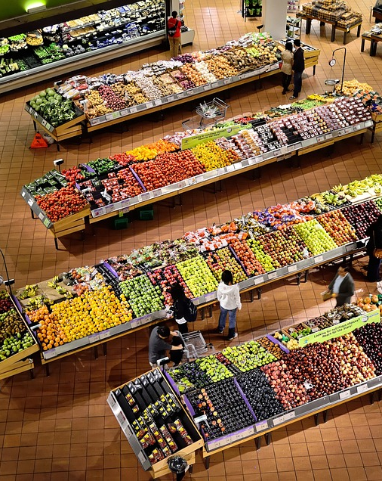
Customer Personality Analysis
Group 3
Problem Statement :
- Analyze the effectiveness of discounts on customer purchasing behavior.
Notes:
To change the image on this slide, select the picture and delete it. Then click the Pictures icon in the placeholder to insert your own image.

Slide 2
Introduction (What Data Did we Possess?)
Customer Demographics (ID, Year of Birth, Education, Marital Status, and Income)
Household Compositions (KidHome, TeenHome)
Purchasing Behavior (Amount Spent on Items & Discounted Deals Purchased)
Promotional Campaigns (1 to 5 and Response Campaign)
Shopping Channels

Slide 3
Methodology and Work Flow
Data Preparation & Cleaning
EDA
Strategic Recommendation

Slide 4

Exploratory Data Analysis & Visualization

Slide 5
Customer Segmentation
Customers have been segmented on various factors to assess their purchasing behavior when it comes to discounts. Mostly they are dissected:
Level of Income
Level of Education
Amount of Spending
Discount Used or Not

Slide 6
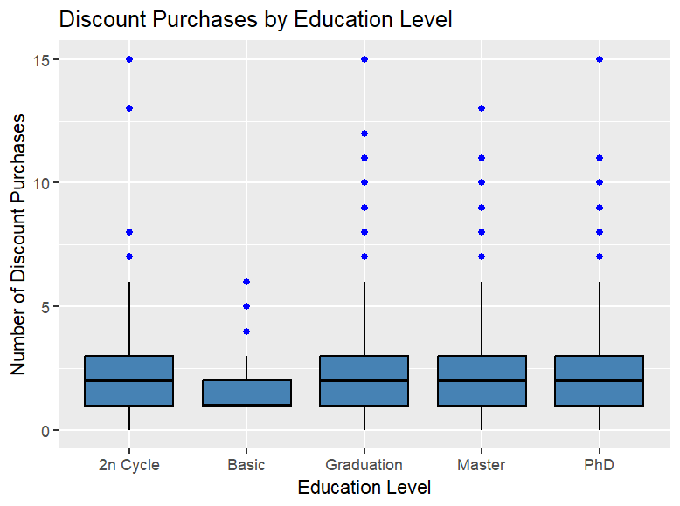
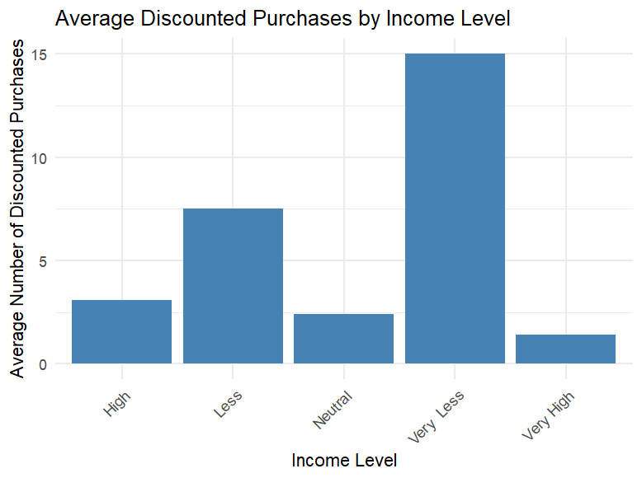
Discount Purchases Based on Income Level & Education
The 'Very Less' income group shows the highest average number of discounted purchases, while the ‘Very High' income group has the lowest average.
The 'High' and 'Very High' income groups show significantly fewer average discounted purchases than the 'Less' group.
Individuals with 'Master' and 'PhD' levels of education have a wider range of discount purchases, with several outliers indicating high numbers of discount purchases.
'2n Cycle' and 'Basic' education levels show a more consistent, but lower number of discount purchases.

Slide 7
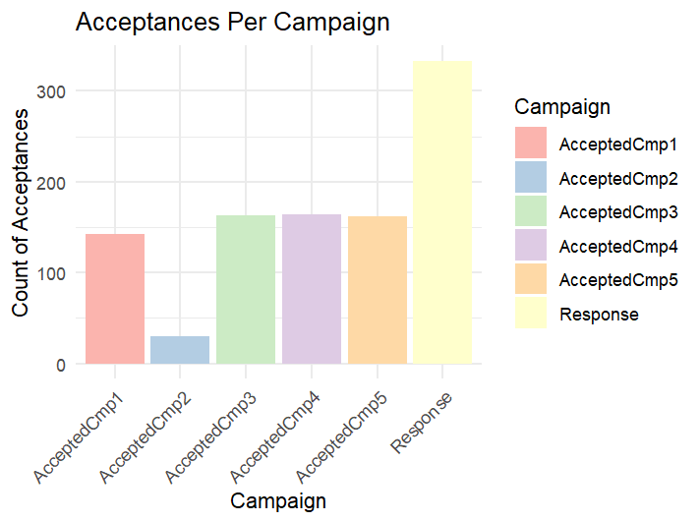
Most Successful Promotional Campaign
The Response Campaign stood out as the winner as it resonated with the audience.
The second campaign significantly underperformed in comparison to its counterparts, marking it as the least engaging initiative.
Notable variations across Campaigns 1, 3, 4 & 5 suggesting varying degrees of alignment with customer interests and preferences.

Slide 8
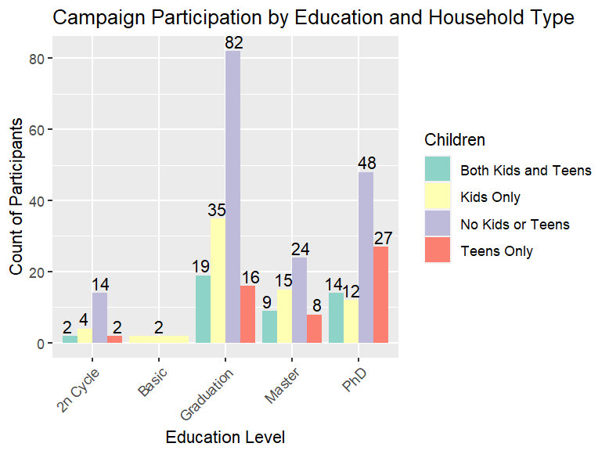
Campaign Participation By Education and Household Type
Graduate Customers who don’t have kids saw the most number of participants for Campaigns.
Customers with No Kids or Teens in general participated more in campaigns
Very few '2n Cycle' and 'Basic' level participants joined the campaign, regardless of household type.

Slide 9
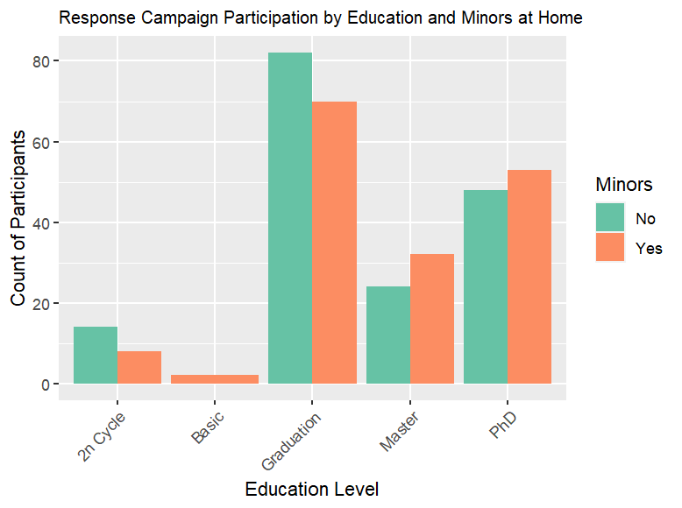
Educated Customers Purchase Using Campaigns?
Most participants who joined the 'Response' campaign have a 'Graduation' level education.
Having kids at home didn't consistently affect whether people participated in the campaign.
Fewer people with 'Basic' or '2n Cycle' education levels took part in the campaign.

Slide 10
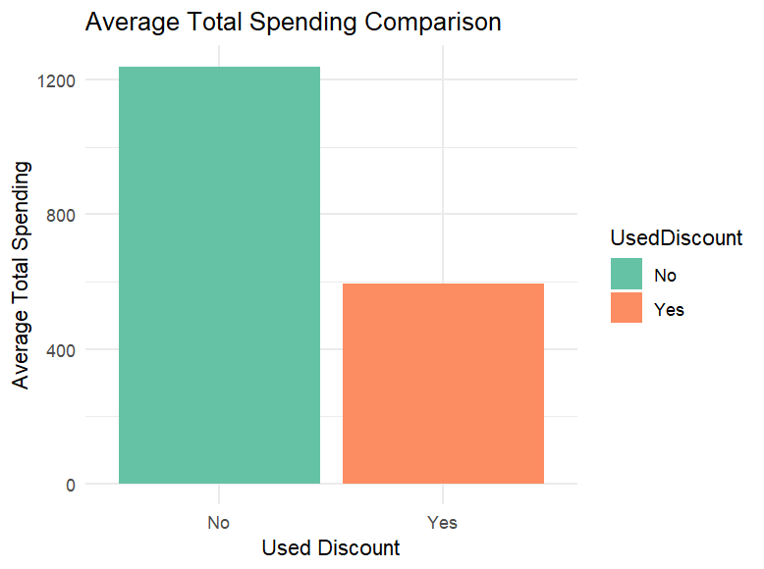
Discounted Purchases Vs Non Discounted
Used Discount | No | Yes
Mean | $12.38M | $5.94M
Median | $13.56M | $3.86M
Standard Deviation | $7.97M | $5.91M
Frequency of Purchase | 5.57 | 5.79

Slide 11
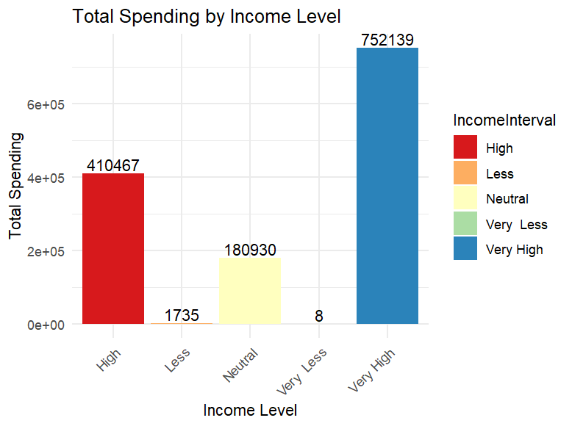
Do the Rich Care About Discounts?
From the previous slide
Customers with above-average income levels spend on items regardless of discounts
The 'Less', 'Neutral', and 'Very Less' income groups contribute much less to the total spending mostly from discounts that too.

Slide 12
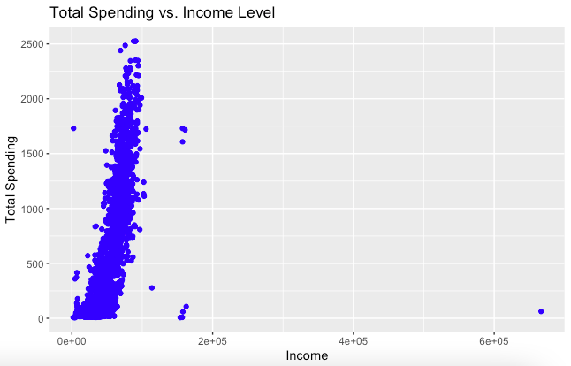
What kind of correlation can we see?
Income Level and Total Spending seem to have a positive correlation
As income increases the spending increases as well.
This corroborates our previous point that customers with high-income levels spend more regardless of discount

Slide 13
Insights & Strategic Recommendations

Slide 14
Insights
EDA Employed on Questions | Key Insight Drawn
Discount Purchases Based on Income Level & Education | The higher variability in the 'Master' and 'PhD' categories may suggest that customers with higher education levels are more likely to take advantage of discounts for larger purchases. The 'High' and 'Very High' income groups' lower average might suggest they are less motivated by discounts or that the discounts are not on products they typically purchase.
Most Successful Promotional Campaign | The success of the 'Response' campaign may warrant a deeper dive to uncover the key drivers behind its outstanding performance
Campaign Participation By Education and Household Type | Graduate Level customers mainly resonate with the campaigns that are advertised and mainly with no minors at home

Slide 15
Insights
EDA Employed on Questions | Key Insight Drawn
Educated Customers Purchase Using Campaigns? | The high participation of customers with a 'Graduation' education level may reflect campaign content that aligns well with the values or interests of this group.
Do the rich care about Discounts? | The spending power of the 'Very High' income group suggests that they may not be as price-sensitive and could be targeted with premium offerings. Lower income groups may benefit from more aggressive discounts or value-focused marketing to boost their spending.
Correlation Between Income & Total Spending | The spread of spending at lower income levels might reflect budget constraints or a selective purchasing approach focused on essential or discounted items. The trend of increased spending with higher income supports the common economic theory that as disposable income rises, so does consumer spending.

Slide 16
Strategic Recommendations
Tailor discount strategies to appeal more to the spending habits of customers with higher education, perhaps with offers on premium products.
Focus on creating more compelling discount offers for the 'Very Less' income group to encourage increased purchasing.
For the 'Less', 'Neutral', and 'Very Less' income groups, consider loyalty programs, special discounts, and promotions to increase engagement and spending.
Focus on tending to High-Income customers since they are not driven by discounts.
Develop a family-focused promotional campaign to attract customers with minors at home.
Remove or try to improve promotional campaign 2 as it underperformed. Try to gain customer feedback and

Slide 17

Thank you

